Slide 1

Bank Marketing case study
Sanket Patel
100800990

Slide 2
Business Problem and Data Sources
Instead of using a scattershot approach, a targeted marketing solution not only reduces marketing costs, but also optimizes resources. The purpose of this project is to develop a solution for a targeted marketing campaign for potential customers of a banking product (term deposit) in order to optimize marketing costs.
Classify if a customer will subscribe to term deposit or not, compare different models (Logistic Regression, Decision tree, Random Forest, SVM, KNN, ensemble models(Bagging/boosting) and ANN etc.) based on their performance, identify the best solution and deploy it in practice.

Slide 3
Data source
Data Source: https://archive.ics.uci.edu/ml/datasets/Bank+Marketing
This example uses data related with direct marketing campaigns of a Portuguese banking institution. The marketing campaigns were based on phone calls. Often, more than one contact to the same client was required, in order to assess if the product (bank term deposit) would be subscribed ('yes') or not ('no'). The marketing campaigns were based on phone calls. Often, more than one contact to the same client was required, in order to assess if the product (bank term deposit) would be subscribed ('yes') or not ('no').

Slide 4
Insights based on eda
The average age of customers who bought the term deposit is higher than that of the customers who didn’t.
The pdays (days since the customer was last contacted) is understandably lower for the customers who bought it. The lower the pdays, the better the memory of the last call and hence the better chances of a sale.
Surprisingly, campaigns (number of contacts or calls made during the current campaign) are lower for customers who bought the term deposit.

Slide 5
Important features after feature selection
campaign, cons_conf_idx, contact_telephone, default_unknown, default_yes, duration, emp_var_rate, job_blue_collar, job_entrepreneur, job_management, job_retired, job_self_employed, job_student, month_dec, month_jun, month_mar, month_may, month_nov, month_oct, month_sep, poutcome_success, previous,

Slide 6
Solution Architecture
Data Acquisition and Cleansing: Handling categorical features, missing values and outliers.
EDA and Insights: Basic Exploratory Analysis
Feature Engineering: RFE, Select K-Best and VIF
ML Algorithms
Decision Trees
Random Forest
Support Vector Machines (SVC)
Artificial Neural Networks (ANN)
XG Boost
Hyper parameter tuning

Slide 7
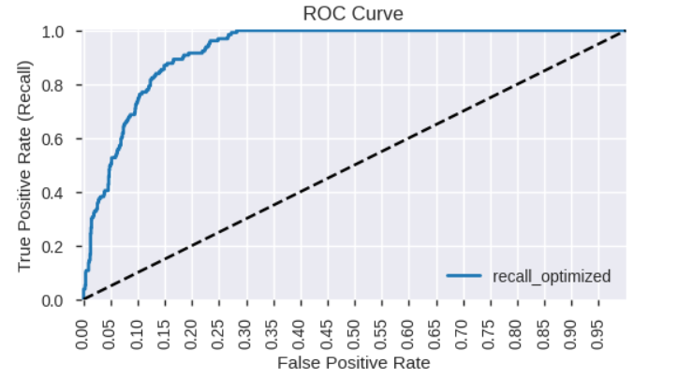
Logistic Regression(AUC:92.76%)

Slide 8
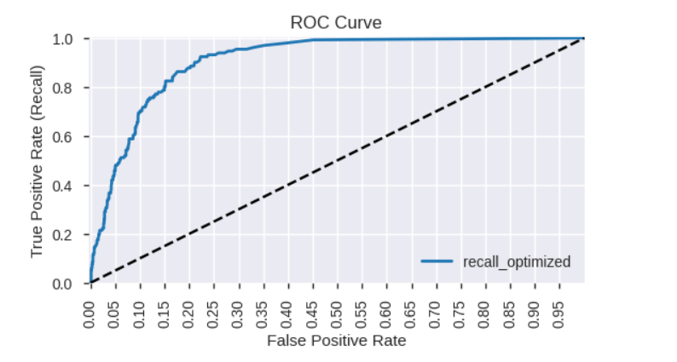
Random Forest: (AUC:90.74%)

Slide 9
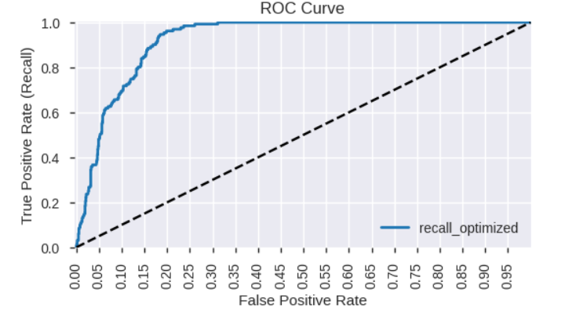
XGBoost (AUC: 92.48%)

Slide 10
Model comparisons
Decision Trees (AUC: 0.9086624775583484)
Random Forest (AUC: 0.6995958688819038)
Support Vector Machines (SVC) (AUC:0.7691064211944321)
Artificial Neural Networks (ANN) (AUC:0.7178335808780354)
XG Boost (AUC:0.9312389900176159)
Best model based on AUC: XG BOOST

Slide 11
Deployment (Where and How to access)
Heroku APP (PAAS)
Model is deployed on a Heroku app using flask framework.
User point of view: https://td-subscription-prediction-api.herokuapp.com/

Slide 12
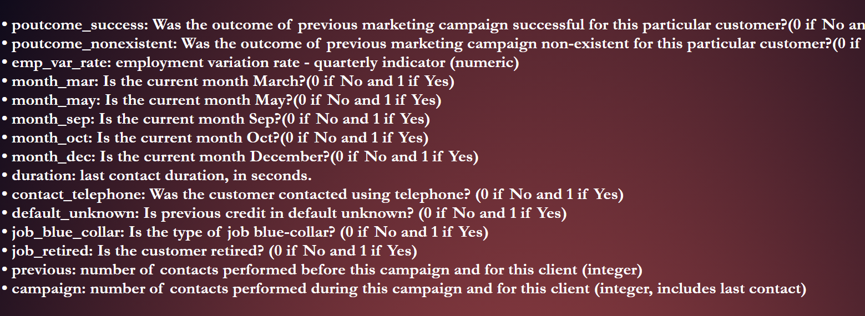
Features to be Entered

Slide 13
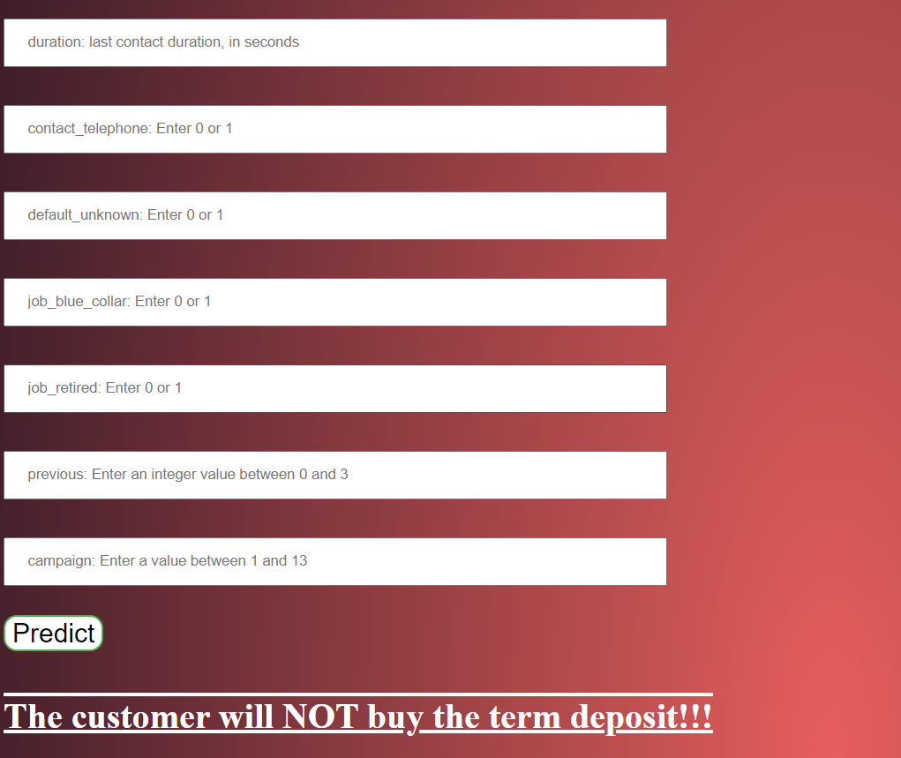
Prediction AT the bottom

Slide 14
Thank you

